Slide 1
Chapter 7:
Advanced SQL
Modern Database Management
10th Edition
Jeffrey A. Hoffer, V. Ramesh,
Heikki Topi
© 2011 Pearson Education, Inc. Publishing as Prentice Hall

Slide 2
Objectives
Understand triggers and stored procedures
Discuss SQL:200n standard and its extension of SQL-92
User Defined Functions (UDFs)
Notes:
Write noncorrelated and correlated subqueries – very commonly used in applications
Establish referential integrity in SQL
Understand triggers and stored procedures

Slide 3
SQL:1999 and SQL:200N Enhancements/Extensions
User-defined data types (UDT)
  Subclasses of standard types or an object type
Analytical functions (for OLAP)
  CEILING, FLOOR, SQRT, RANK, DENSE_RANK, ROLLUP, CUBE, SAMPLE,
  WINDOW–improved numerical analysis capabilities
New Data Types
  BIGINT, MULTISET (collection), XML
CREATE TABLE LIKE–create a new table similar to an existing one
MERGE
Notes:
Create your own data types
Analytical functions great for calculating, moving averages, moving standard deviation, other statistical calculations
MERGE – doing INSERT, AND UPDATE at the same time

Slide 4
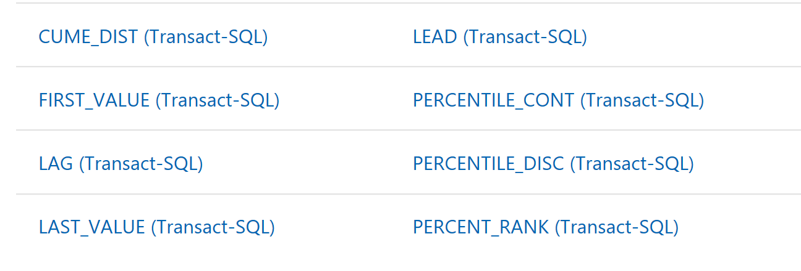
SQL Server Analytical Functions
https://docs.microsoft.com/en-us/sql/t-sql/functions/analytic-functions-transact-sql?view=sql-server-2017

Slide 5
SQL:1999 and SQL:200N Enhancements/Extensions (cont.)
Persistent Stored Modules (SQL/PSM)
  Capability to create and drop code modules
  New statements:
    CASE, IF, LOOP, FOR, WHILE, etc.
    Makes SQL into a procedural language
Oracle has propriety version called PL/SQL, and Microsoft SQL Server has Transact/SQL
Notes:
Originally SQL was created as tool to retrieve and update and insert data into databases.
DBMS vendors saw a need in having procedural language within the db.
The standard was first introduced in SQL:96 standards. What can you do with PSM:
Variable declarations,
Control flow
Assignment of expressions
Exception handling
It defines stored procedures

Slide 6
Routines and Triggers
Routines
  Program modules that execute on demand
Functions–routines that return values and take input parameters
Procedures–routines that do not return values and can take input or output parameters
Triggers–routines that execute in response to a database event (INSERT, UPDATE, or DELETE)
Notes:
Routine is a block of code that does something, much like other programing languages such as java or C++
The tools available in those languages are also available in databases.
There is 3 basic types of routines in the database world:
Function, routine that takes input values and return values back
Stored procedures – returns that cannot return values but take input parameters
Triggers – routines that execute when an even occurs! For example a delete of a table

Slide 7
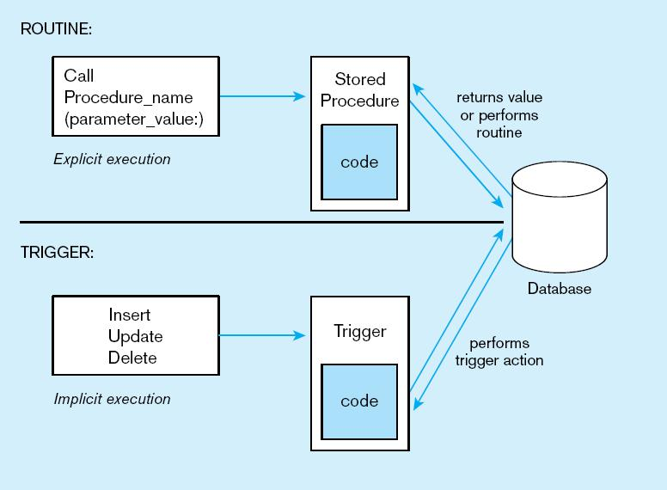
Figure7-11Triggers contrasted with stored procedures
Procedures are called explicitly
Triggers are event-driven
Source: adapted from Mullins, 1995.
Notes:
Procedures are called explicitly.
Triggers are called when a DML statement is executed

Slide 8
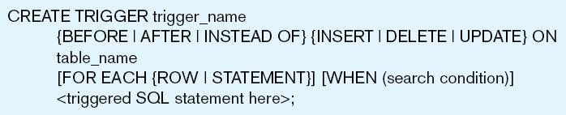
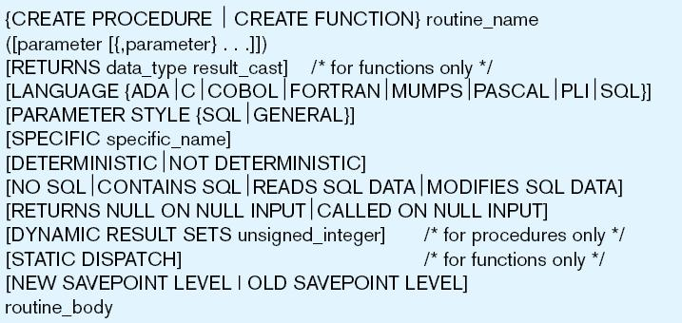
Figure 7-12 Simplified trigger syntax, SQL:200n
Figure 7-13 Syntax for creating a routine, SQL:200n
Notes:
INSTEAD OF triggers skips the executition.

Slide 9
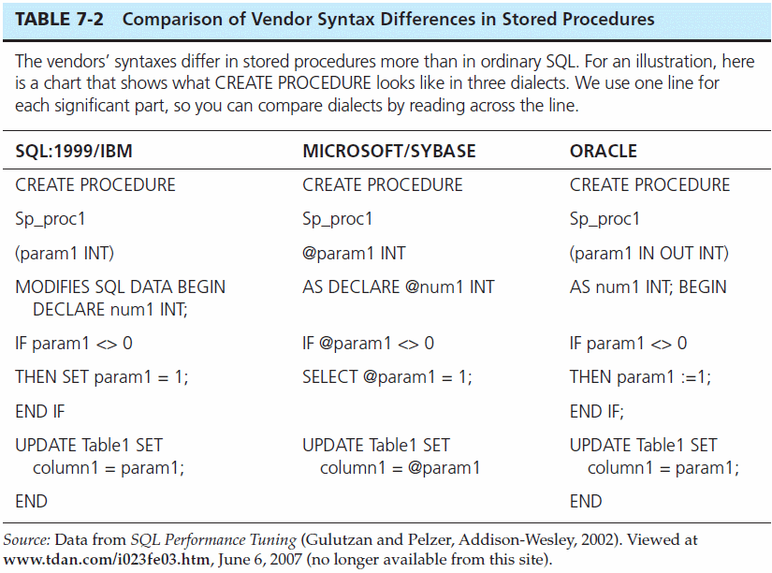
Notes:
The syntax varies from language to language/ the structure is very similar!

Slide 10
Embedded and Dynamic SQL
Embedded SQL
  Including hard-coded SQL statements in a program written in another language such as C or Java
Dynamic SQL
  Ability for an application program to generate SQL code on the fly, as the application is running
Notes:
Remove

Slide 11
Example of SQL Server Stored Procedures
Notes:
ALTER PROCEDURE GetEmployees @depar_no varchar(5)
AS
BEGIN
SELECT * FROM employee
WHERE dept_no =@depar_no
END
EXEC GetEmployees 'D1’
ALTER PROCEDURE ChangeEmployeeDept @emp_no INT, @new_depar_no varchar(5)
AS
BEGIN
UPDATE employee set dept_no =@new_depar_no
WHERE emp_no = @emp_no
END
EXEC ChangeEmployeeDept 15000, 'D1’
EXEC ChangeEmployeeDept @emp_no= 15000, @new_depar_no='D1'

Slide 12
Stored Procedure Exercise
Create a stored procedure that takes Country as an input parameter, and outputs a list of employees in that country.
Procedure Name: GetEmployees @Country
Results:
First Name, Last Name, City, Country
Note: All locations are in US except London which is England
Notes:
create procedure GetEmployee @Country varchar(25)
AS
BEGIN
SELECT e.emp_fname, e.emp_lname, location AS City,
CASE when d.location ='London' THEN 'England' ELSE 'USA' END AS Country
FROM employee e JOIN department d ON e.dept_no = d.dept_no
WHERE CASE when d.location ='London' THEN 'England' ELSE 'USA' END =@Country
END
EXEC GetEmployee 'England'

Slide 13
UDF Exercise
Create a UDF that takes @City as an input parameter, and returns country.
Procedure Name: GetCountry (@city)
Note: All locations are in US except London which is England
Notes:
ALTER FUNCTION GetCountry ( @city varchar(25) )
RETURNS varchar(25)
BEGIN
declare @country varchar(25)
select @country =
case when location ='London' then 'England' else 'USA' end
from department
where location = @city
RETURN @country
END
select dbo.GetCountry('Boston')
select *,
dbo.GetCountry(location) AS Country
from department

